Slide 1


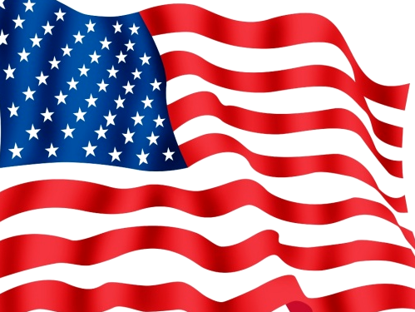
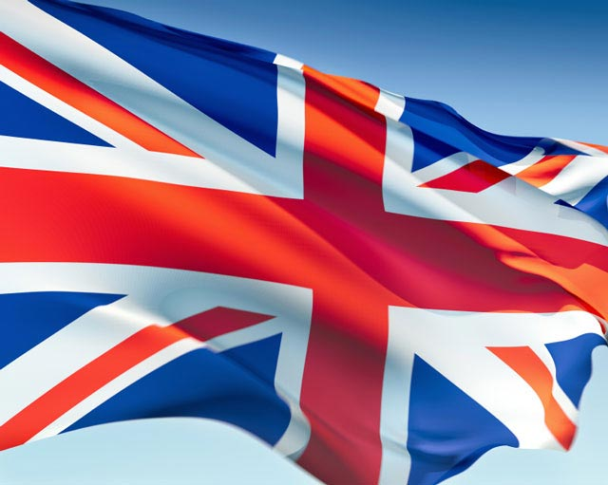
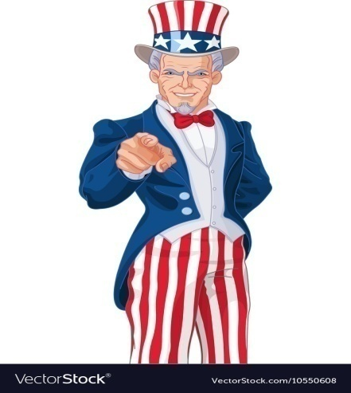
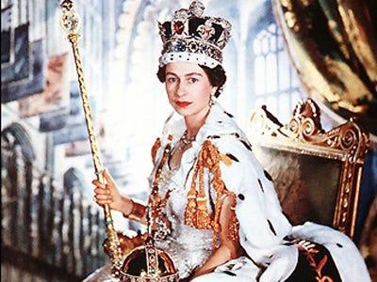
Warm-Up
Can you tell the significance of the below words?
The Bald Eagle
Star Spangled Banner
The Union Jack
The Crown
Uncle Sam

Slide 2
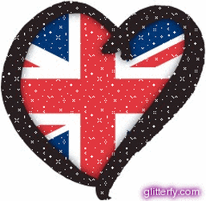
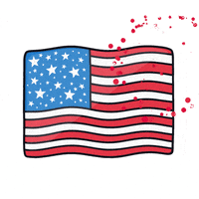
Distinctive Symbols & Landmarks
Name as many as possible for each nation?
United Kingdom
United States
BIG BEN
Shakespeare
Statue of Liberty
E. Hemingway
London Bridge
Tea
Golden Gate Bridge
Coffee
London Eye
The Royal Guard
Mount Rushmore
GI Joe
Buckingham Place
White House
Red Phone Booth
Elvis Prestley
StoneHenge
The Grand Canyon
The Beatles
Hollywood
Double-Decker Bus
Cricket
Empire State Building
American Football
Fish and Chips
Rugby
Hot Dogs
Baseball

Slide 3

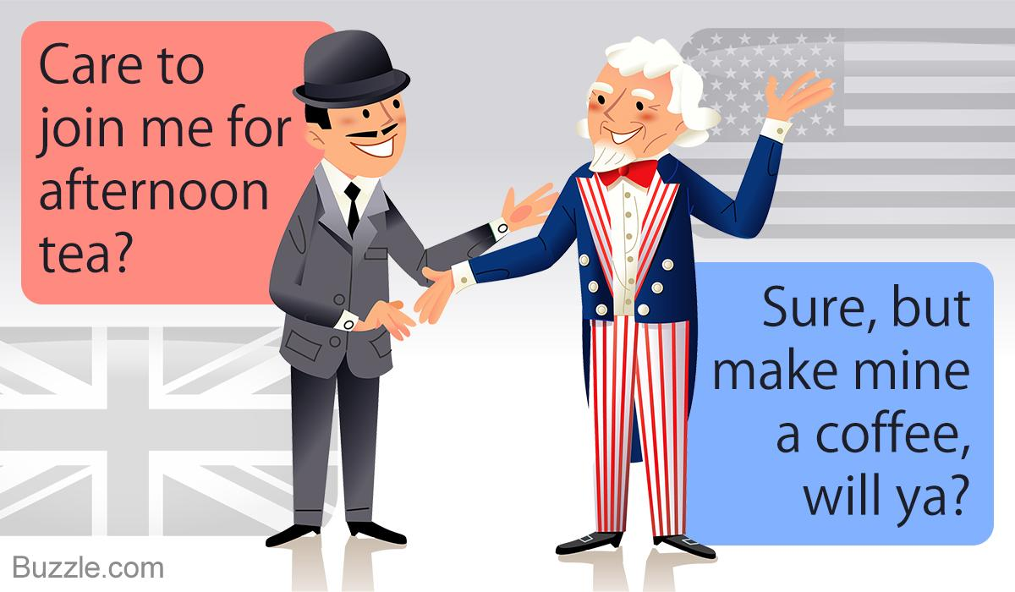
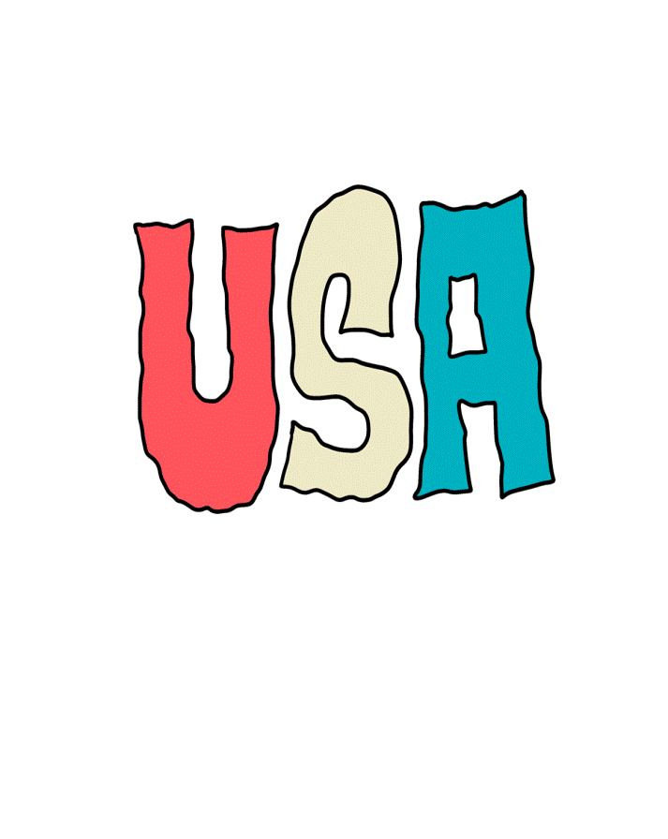
The United Kingdom and the United States share various cultural aspects, yet, many divergences divide the two nations as well:

Slide 4
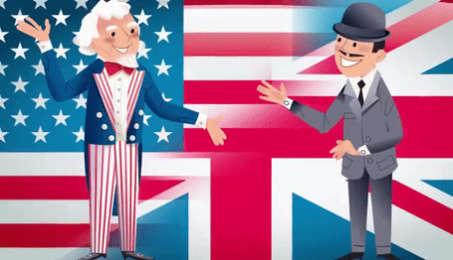
Divergences and Convergences
Let’s brainstorm what unites and what parts them:
History (Britain’s occupation of the north america until 1776)
The Climate / Weather
Food
Map Location (Europe Vs America)
Dress Code (Casual US Vs Formal UK)
Official Language (English) / BrE Vs AmE
Lifestyle and traditions
National Currency (Sterling Pound Vs US Dollar)
International Policy (WW2 & NATO Military Alliances)
Political System (Parlamentary Monarchy Vs Constitutional Federal Republic)
Official religion (Christianity)
Geography ( 4 independant sovereign states Vs 50 Federated States)

Slide 5
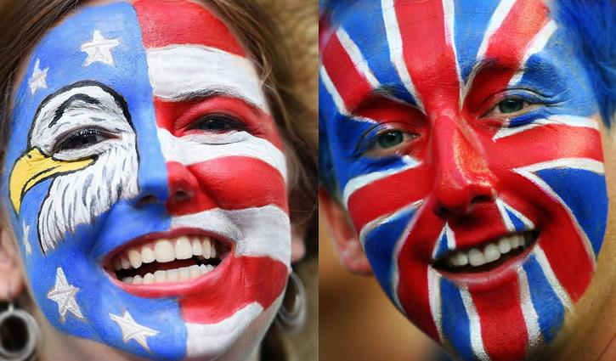
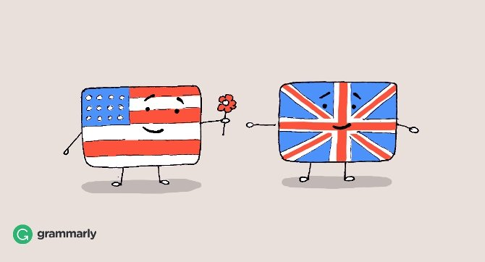

One Language, Two Cultures..
CCCA3 Lesson 02

Slide 6
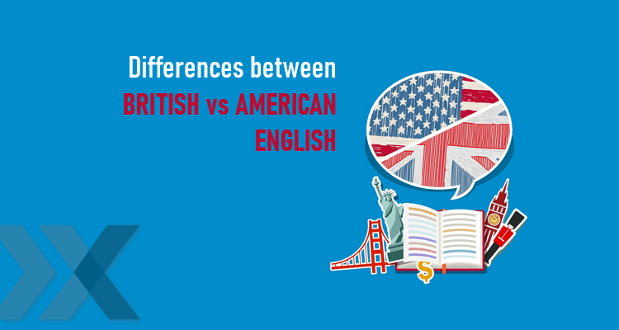
Learning Outcomes
  By the end of this session you will be able to:
Relate to English language origins & variations
Tell Language differences between BrE & AmE
Identify borrowed words in English language
Use Past Perfect tenses correctly

Slide 7
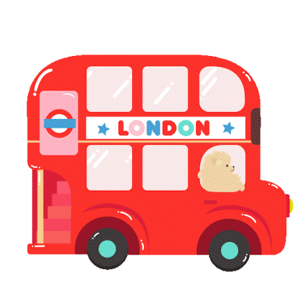
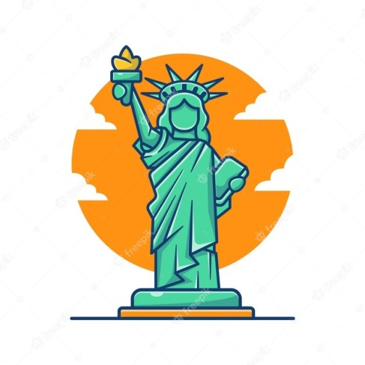
Presentation Outline
2
English language :History & Development
3
BrE Vs AmE: Differences at all language levels
1
4
Warm up
Colloquial language, Slangs & Idioms in BrE & AmE
5
Loanwords in English Language
6
Past Perfect Simple & Continuous
7

Slide 8

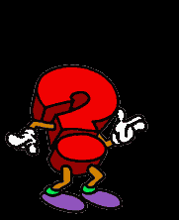
Quiz - What do you know about the English language?
1. The ultimate origins of the English language lie in which language family?
A. Indo-European B. Latin C. North American
2. Another name for old english is Anglo-Saxon
A. True B. False
3. In which part of Europe did the English language originate?
A. Germany and the Netherlands B. Wales C. England
4. Approximately how many words are there in the English language?
A. between 20,000 and 30,000 B. 770,550 C. More than a million
5. What percentage of English words actually have their origin in a different language?
A. Over 20% B. Over 60% C. Over80%
6. How many languages is it estimated English has “borrowed” words from?
A. 55 B. 380 C. 126

Slide 9
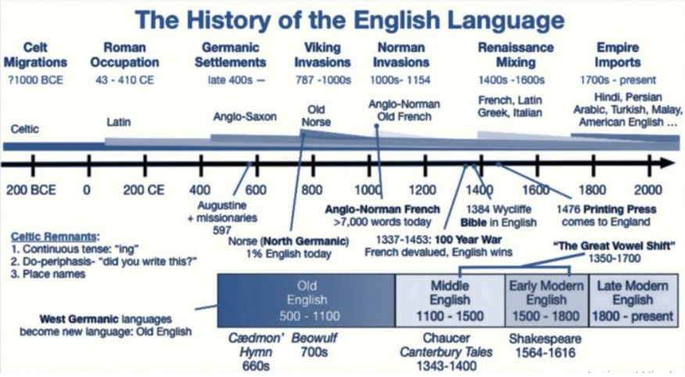
Origins of English language

Slide 10
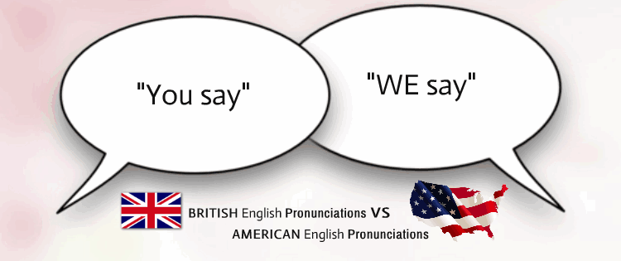
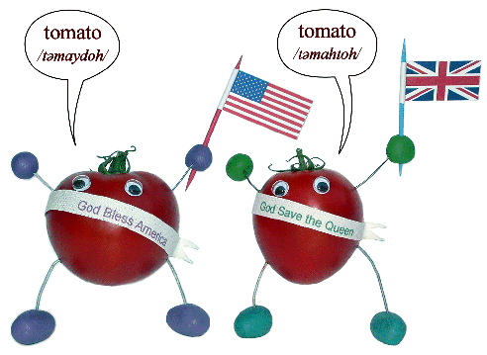
English is the second-most widely spoken native tongue globally and an official language in 53 countries. English is the main language for global communication and the most popular language among foreign-language learners.
How did this divergence occur?
The English language was introduced to the Americans through British colonization in the early 17th century and it spread to many parts of the world because of the strength of the British empire. Over the years, English spoken in the United States and in Britain started diverging from each other in various aspects. This led to two dialects in the form of the American English and the British English.

Slide 11
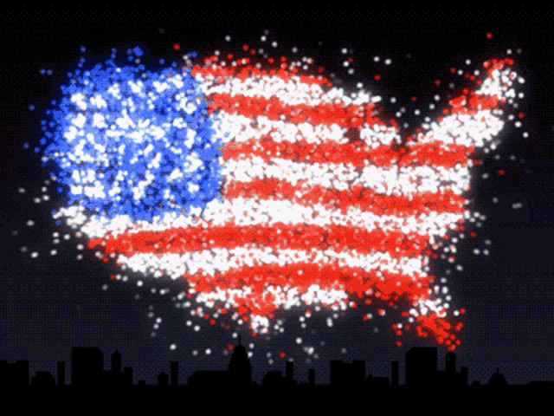
Over the last few decades, British English has come under increasing influence from American English.
The reason that there is so much American influence in BrE is the result of the following:
Magnitude of publishing industry in the U.S.
Magnitude of mass media influence on a worldwide scale
Appeal of American popular culture on
language and habits worldwide
International political and economic position of the U.S.

Slide 12
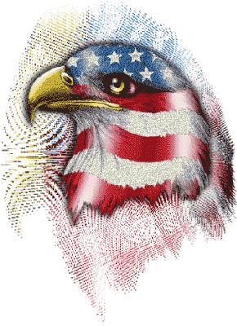
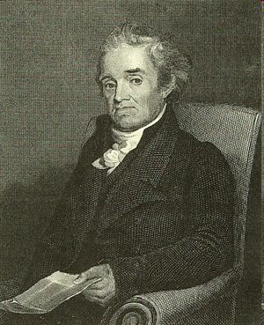
Noah Webster
Writer of the first American dictionary in 1806
Believed that Americans’ language should reflect the way they spoke, and be distinct from British English
Came of age during the American revolution, and therefore placed great emphasis on America’s cultural separation from England

Slide 13
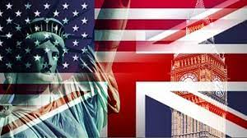
Guess American or British culture
Love for Literature and Arts
Patriotism
Tea culture
Politeness and formality
Individualism
British
American
British
British
American

Slide 14
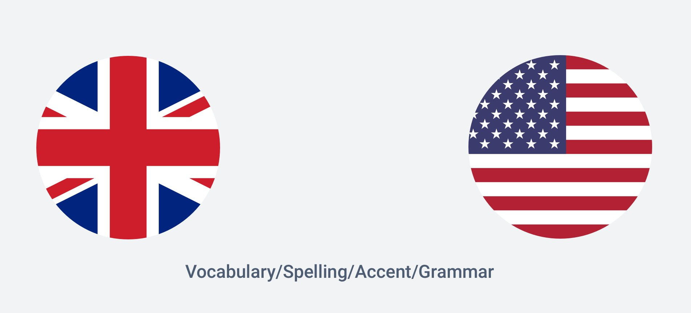
So at what language levels is American English different from British English?

Slide 15
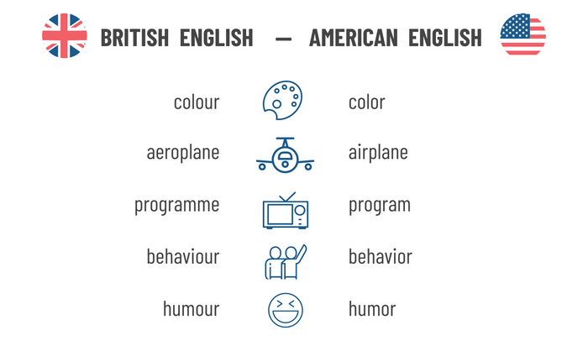
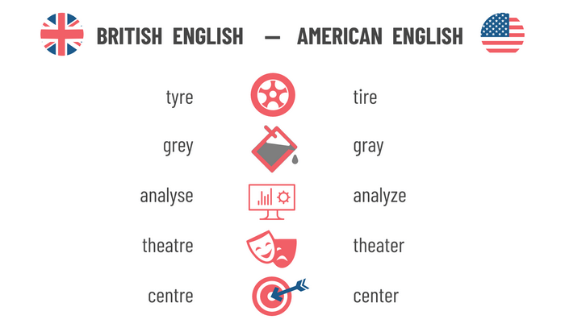
Differences in Spelling
What are the differences you know?
The spelling differences between British and American English also include letter changes and letter reversals.
The key spelling difference between BrE and AmE is the letter omission in the latter. For example, in writing, the British keep the letters that account for the spelling .

Slide 16

How would you pronounce these words?
Schedule
In the UK, the prevalent pronunciation is /ˈʃɛdjuːl/ (shed-yool), while the prevalent pronunciation in the US is /ˈskɛdʒuːl/ (skedzh-ool).
ˈ
Leisure
In British English it’s pronounced /ˈleʒ.ə/ (leizh- uh),
however Americans say /ˈliːʒɚr/ (LEE-zher)
What are other pronunciation differences you know?

Slide 17
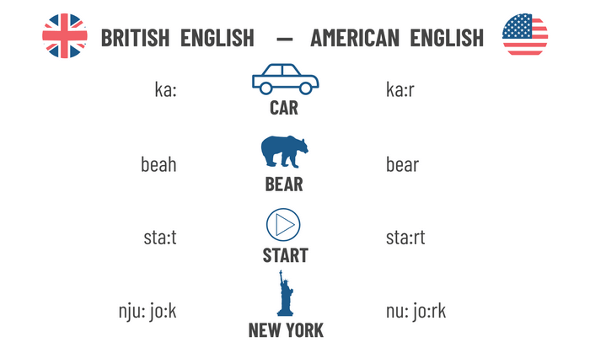
Differences in Pronunciation
While the r sound is pronounced in AmE, it remains silent in BrE unless it occupies an initial syllable position.
British English and American English differ even more regarding their pronunciation.
For the vowel “O”, in Britain they back rounded open sound /ɒ/ for words like SHOP /ʃɒp/, LOST /lɒst/ and HOT /hɒt/. In American they don’t round the lips, so it’s: /ʃɑp/, /lɑst/ & /hɑt/.

Slide 18
Differences in Pronunciation
The “ing” form
American do not pronounce the "g" in many words ending "ing".
Examples"Running/Runnin’
T's versus D's
Britons pronounce their t sounds with precision. Americans tend to either drop their t completely, or replace them with a d.
Here are some examples:
Mountain/Moun'in
Daughter/Dawder,
Letter/ledder
The Rounded A
In the UK the A is pronounced in a rounded way. The mouth have a rounded shape. Americans pronounce some A this way, such as "park" and "car", but most a's have a flatter sound, like the a in "hat“ or “cat”.
Example: the "a" in the word "ask" is pronounced like the a in "hat" in America but in Britain the "a" in "ask" is pronounced more like the "a" in "car" or "park".

Slide 19
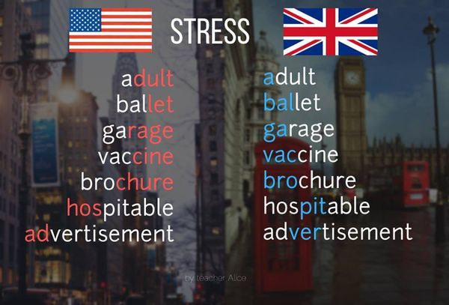
Differences in Word Stress
Americans and Britons agree in most cases on where a word in stressed. For example, everyone says pencil and relax, cinema and consider, but the following words are stressed differently in the two dialects:

Slide 20
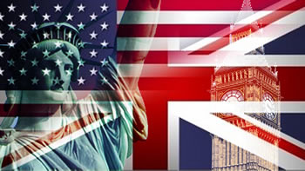
American vs British Grammatical Differences
The differences between British and American English grammar are slightly more complicated. The differences are small, but they are significant.
Take the verb to have, for instance. To talk about possession, BrE uses the verb to have got (I have got a book.), whereas AmE uses to have (I have a book.). An important note: the verb have got is also used in AmE, but mostly to indicate obligation (I have got to go.).
The present perfect tense usage differs as well. The British normally use the auxiliary have (I have just arrived.) in this tense, whereas the Americans usually omit this verb. As a result, the sentences sound simpler: I just arrived.

Slide 21
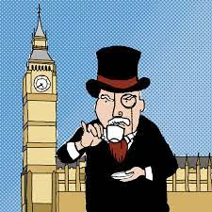
Other Grammar Differences
Americans are much more likely to be technically correct in the agreement of collective noun and verb form than Britons.
American English | British English
The team is playing well this season. | The team are playing well.
The government is | The government are
The police is | The police are
Past forms of the verbs may also differ
American English | British English
burned, learned, dreamed | burnt, learnt, dreamt
fit | fitted
gotten | got

Slide 22
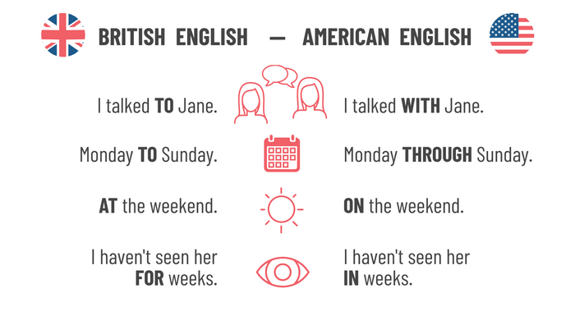
Differences also concern preposition usage:
Guess the equivalent preposition in each example.
?
?
?
?
The grammatical differences also include irregular verbs, for example:
British English American English
spill, spilt, spilt spill, spilled, spilled
dive, dived, dived dive, dove, dived

Slide 23
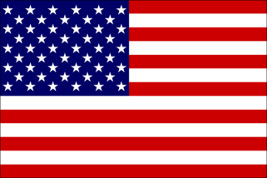
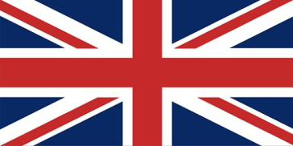
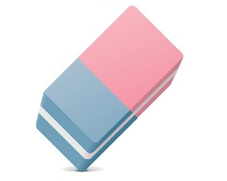
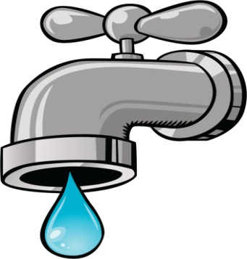
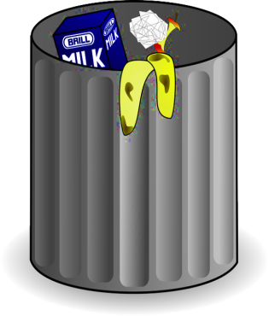
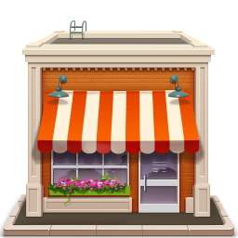
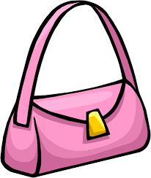
Can you name these objects in English?
Eraser
Rubber
Faucet
Tap
Garbage
Rubbish
Store
Shop
Handbag
Purse

Slide 24


Can you name these things in English?
Flashlight
Torch
Jelly
Jam

Slide 25
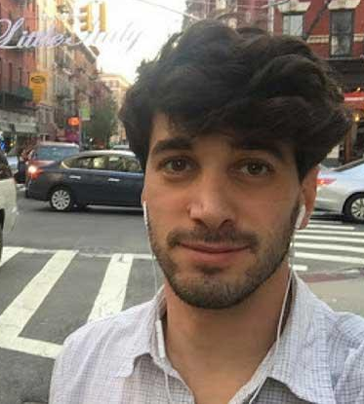
Hi dudes and dudettes, I’m Chad from New
York City. Fill in the gaps for me please. Alright!!
It was getting near lunchtime and I needed some (1) ___________, so I left the (2) ___________ and drove towards the nearest town. There was a station just outside the town and I decided to stop and have a look round. I put the car in a (3) _______________ and took a (4) ___________ to the center. It was noon and very hot, so I stopped at a little (5) ___________ with tables on the (6) ___________. I started talking to a (7) ___________ driver, who gave me a history of the town, and afterwards he took me on a guided tour. It made a nice break.
gas
motorway
parking lot
taxi
diner
sidewalk
truck
lorry diner cab parking lot petrol truck pavement motorway gas taxi café sidewalk car park freeway

Slide 26
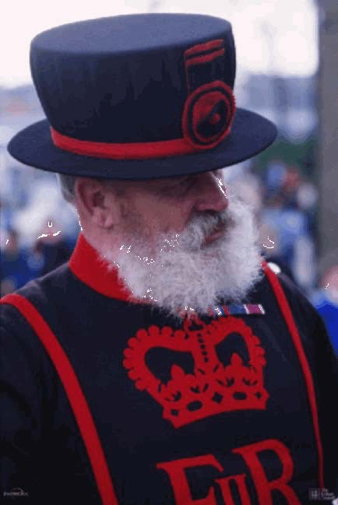
Hello everyone. I’m Basil from London. Could you please fill in the gaps for me? Jolly good!!
Now can you remember the British words to complete the same text with?
It was getting near lunchtime and I needed some (1) ___________, so I left the (2) ___________ and drove towards the nearest town. There was a station just outside the town and I decided to stop and have a look round. I put the car in a (3) _____________ and took a (4) ___________ to the centre. It was midday and very hot, so I stopped at a little (5) ___________ with tables on the (6) ___________. I started talking to a (7) ___________ driver, who gave me a history of the town, and afterwards he took me on a guided tour. It made a nice break.
petrol
freeway
car park
cab
café
pavement
lorry

Slide 27
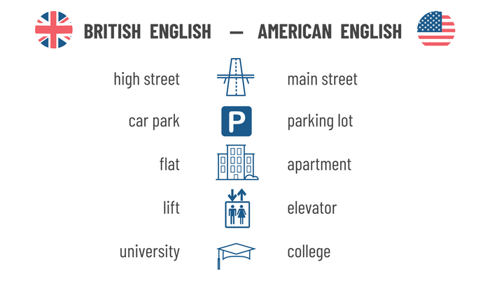
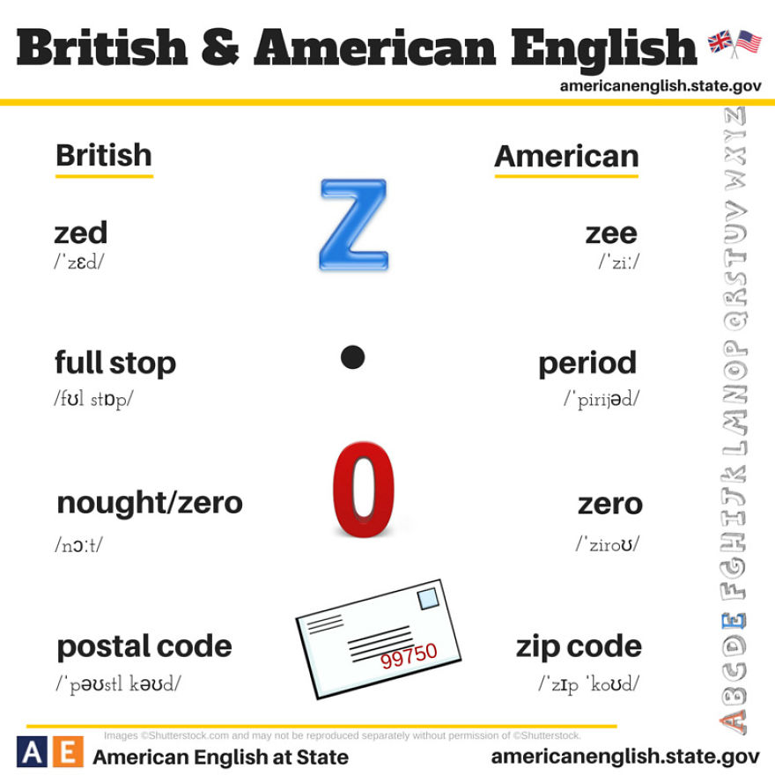
Vocabulary Differences
The vocabulary differences between British and American English are no less tricky. BrE & AmE sometimes use different words to refer to the same thing. In fact, there are many cases of this in both varieties.

Slide 28
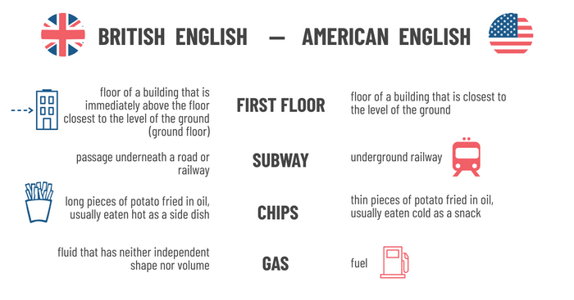
Sometimes these words can be used in just one variety. But a problem arises when a word is used in both varieties but with completely different meanings, for example:

Slide 29
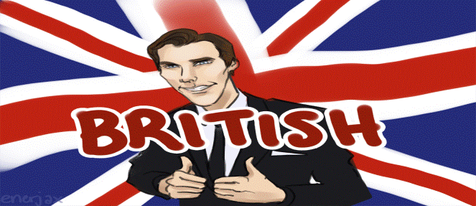
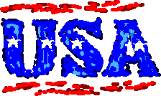
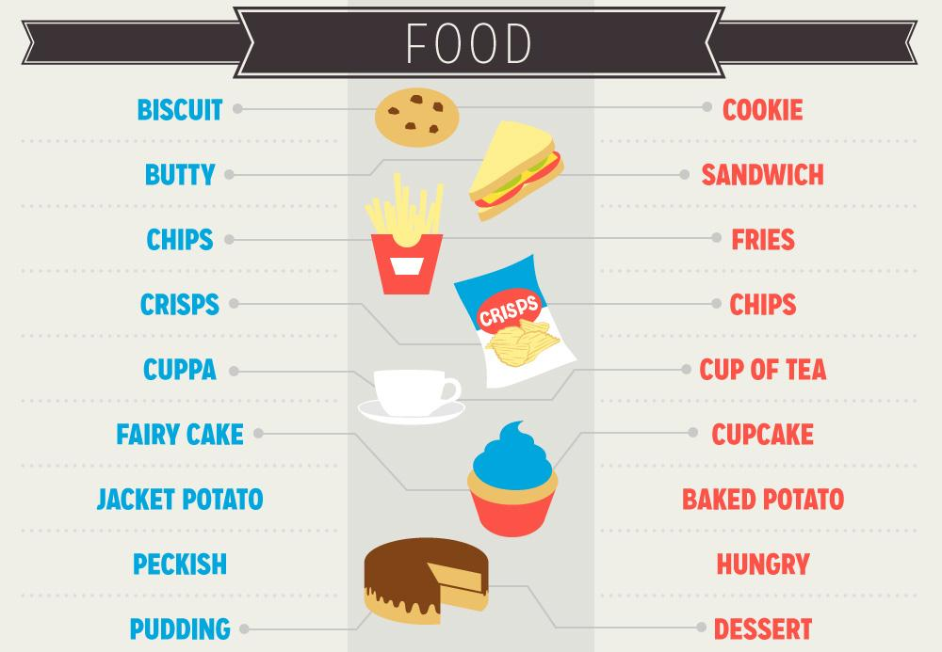

Guess the word in the opposite English Version:
?
?
?
?
?
?
?
?

Slide 30

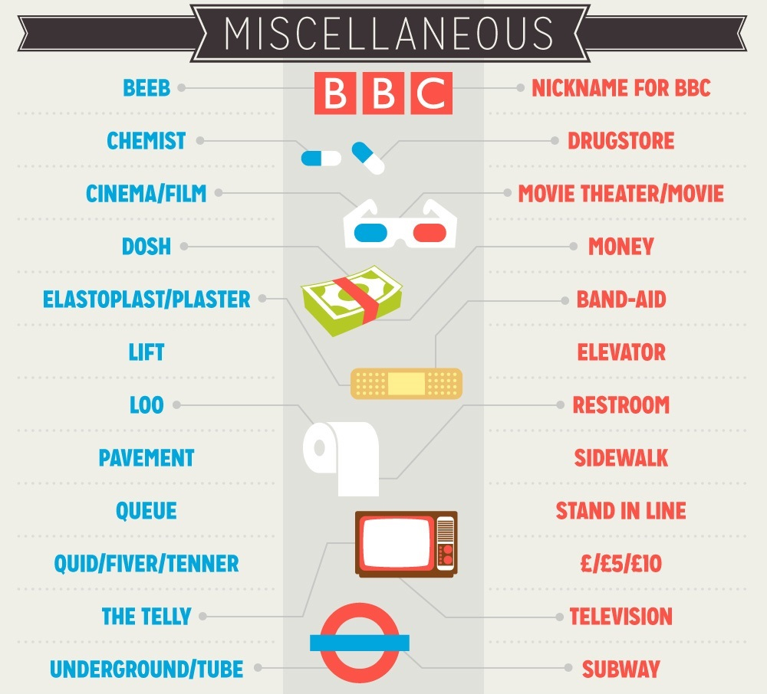
?
?
?
?
?
?
?
?
?

Slide 31
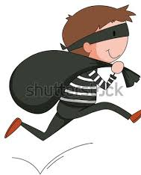

Spot the American
The police are looking for an American bank robber called Butch Cassidy. He robbed a bank in Manchester last Saturday. They are interviewing three different people. All three have British accents, but the police know that Butch Cassidy can imitate a British accent. Read parts of the transcript from each interview.
Can you identify Butch from the language he uses?

Slide 32
Suspect One
I already said this. I didn’t do anything special on the weekend. Friday night I took a shower in my apartment and then went out to see a movie. It was a movie I had already seen, the new Marvel one. I really like action movies. I went with my girlfriend Judy.
Suspect Two
I wasn’t in town at the weekend, and I certainly wasn’t anywhere near the bank on Saturday night. I was at a hotel in Nottingham with a special friend of mine. Shall I give you the hotel phone number? You needn’t bother asking me any more questions. You’ve got the wrong man.
Suspect Three
I’ve already said this. On Saturday night I went to see a film at the cinema. It was the new Marvel one. I don’t really like action films, but my friends really wanted to see it. It was rather boring. After that I went home and had a nice hot bath. I went to bed around midnight.

Slide 33

Answer: Suspect One
I already said this. I didn’t do anything special on the weekend. Friday night I took a shower in my apartment and then went out to see a movie. It was a movie I had already seen, the new Marvel one. I really like action movies. I went with my girlfriend Judy.
The American words and expressions are: already said this (British would use present perfect); on the weekend (British - at the weekend); took a shower (British - had a shower); movie (British - film).

Slide 34
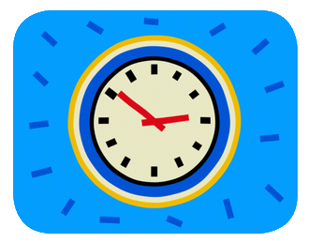
Time & Date Telling
Both languages have a slightly different structure of telling the time.
American English | British English
quarter after ten (10:15) | quarter past ten (10.15)
digital times with a colon 6:00 | digital times with a point 6.00
Month/day/year 12/31/2020 | Day/month/year 31/12/2020
April, 21st | 21 April
American English | British English
Can I get a… | Can I have a…
Two times | Twice
Write me | Write to me
Take a shower | Have a shower
Other Language Divergences

Slide 35
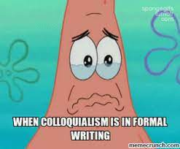
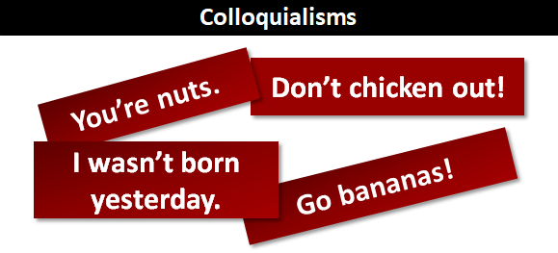
Colloquialism
What is Colloquialism?
Colloquialism or colloquial language is the linguistic style used for casual communication. It is the most common functional style of speech, normally employed in conversation and other informal contexts.

Slide 36

Guess the standard English word from AmE and BrE Colloquial language
Standard word Am Colloquialism Br Colloquialism
crib gaff
homie mate, fam
beat knackered, shattered
hyped, amped buzzing
cop copper, bobby
pissed pissed off
stoked chuffed
wasted, trashed hammered, battered
house
friend
tired
excited
police officer
angry
pleased
drunk

Slide 37

Definition and Meaning of “Slang”
What does it mean when we talk about “slang”?
Slang is a very informal kind of language that is usually only spoken and not written.
It is, especially used by particular groups of people.
Slang is more familiar than colloquial language.
For example, there is:
youth/teen slang
internet slang
army slang
hip-hop/rap slang
slang used by different ethnic groups
Slang is often used unconsciously to linguistically separate its group from other groups. Especially teenagers use slang expressions to differentiate from the old-fashioned way their parents speak.

Slide 38

American Slang phrases and words in British English
Although Americans and the British speak the same language, there are American slang words and phrases which are at least confusing for British. Sometimes they don’t understand them at all.
A common example of this phenomenon is the word “pants.” When hearing the word “pants,” Americans are expecting long pants (Trousers), whereas the British are expecting underwear.
Another significant examples is “to ride shotgun.” i.e. to be in the passenger seat.
If an American would say to his British friend: “I’m driving. You are riding shotgun.” his friend would most likely look at him confused and be completely irritated.
Now, what about you?
What other fun American slang expressions do you know?

Slide 39

Match the slangs with their meanings:
AMERICAN SLANG
to pig out
to drive someone up the wall
a couch potato
a party animal
it's no biggie
a bummer
to have a crush on someone
something is sick
an epic fail
to be hyped
MEANING
it's not a (big) problem
a disappointment
to eat a lot of food in a messy way
someone who loves or really enjoys parties
to be attracted to s.o in a romantic way
a huge failure or complete disaster
to be extremely excited something
something is awesome/really good
someone who always stays inside
to make someone crazy
C
J
I
D
A
B
E
H
F
G

Slide 40

Idioms
An idiom is an expression whose meaning is not predictable from the usual meanings of its constituent elements.
English is a language particularly rich in idioms – those modes of expression peculiar to a language (or dialect) which frequently defy logical and grammatical rules. Without idioms English would lose much of its variety and humor both in speech and writing.

Slide 41

Can you now tell the meaning of each?
Do you know the American versions of these idioms?
British English
Sweep under the carpet
Touch wood
See the wood for the trees
Throw a spanner (in the work)
One’s tuppence worth
Skeleton in the cupboard
Flogging a dead horse
A drop in the ocean
American English
sweep under the rug
knock on wood
see the forest for the trees
throw a wrench (in- the works)
one’s two cents' worth
skeleton in the closet
beating a dead horse
a drop in the bucket
try to hide a problem or keep a problem secret instead of dealing with it
said when you want good luck or a good situation to continue
Being involved in the details of s.th and so not noticing what is important about the thing as a whole
a roadblock that prevents an activity from succeeding
One's opinion or point of view for whatever it may be worth, generally when it is unasked for.
A secret of an embarrassing, guilty or shameful nature that you don’t want to disclose
Waste energy on something that has no chance of succeeding
very tiny part of something big

Slide 42

Complete the sentences with the convenient idiom
knock on wood
Our new venture has got off to a great start, and _________________, we’ll be doing profitable business by the end of the year.
Let’s make sure that we get this done before Suzy comes along and changes her mind again. That will really ___________________________, .
It is always possible to find ____________________, when you dig into family history. Our great, great, grandfather had been in prison for bank robbery.
Your father kept telling me to hush up but you know me, I had to throw ___________________
There are numerous problematic realities that we _________________, one of them being child abuse.
I’ve told him numerous times to manage his routine effectively, but I think I’ve just been ___________________,
I always try to give money to the charity, but sometimes I feel it is just __________________ .
I don't think we can _______________________, at this stage, so let's get an outsider to take a look at the project and give us a progress report.
Idioms
sweep under the rug/ carpet
Touch / knock on wood
see the forest / wood for the trees
throw a wrench / spanner
(in- the works)
one’s two cents’/ tuppence worth
skeleton in the closet / cuppoard
beating / flogging a dead horse
a drop in the bucket / ocean
throw a wrench in the works
a skeleton in the closet
my two cents' worth
sweep under the rug
beating a dead horse
a drop in the bucket
see the forest for the trees

Slide 43

Difference related to cultural values
British and American English have a number of differences which relate to the different cultural values of the two countries. For example, British English contains a number of frequently used metaphors relating to football (‘scoring an own goal’) and cricket (‘a sticky wicket’), while American English uses metaphors relating to baseball (‘in the ball park’).
The two versions of the language also have certain tendencies which are worth bearing in mind. These are not absolute, since individual writers have their own styles which may incorporate aspects of both British and American tendencies.

Slide 44
British English tends to react more slowly to new words and phrases than American English. American English enthusiastically adopts new usages, some of which later pass into general use (e.g. corporate citizen, social performance), and some die out after a short period in fashion (e.g. synergy).
British English has a slight tendency to vagueness and ponderous diction.
American English (at its best) tends to be more direct and vivid.
American English tends to be more slangy than British English.
Both American and British English are keen on euphemisms.
In British English, these are often used for humorous purposes (e.g. to be economical with the truth) or to smooth over something unpleasant. In American English they may be used for prudish reasons (thus lavatory or WC becomes restroom or bathroom), to make something mundane sound important (thus rat catcher becomes rodent operative), or to cover up the truth of something unpleasant (thus civilian deaths in war become collateral damage).

Slide 45

How has English language evolved to have more than
1 million words?
The most common source of new words in modern English is not just the diverging vocabularies of both British and American dialects, nor the proliferation of slang words, but it’s the process simply labeled borrowing, that is, the taking over of words from other languages.
The English Language had adopted a vast number of loan-words from other languages, including alcohol (Arabic), boss (Dutch), croissant (French), lilac (Persian), piano (Italian) and yogurt (Turkish). Other languages borrow terms from English, as can be observed in the Japanese use of suupaamaaketto (supermarket).

Slide 46

What words can you think of that your language has borrowed from English?
2. Do you know any words that English has borrowed from your language?

Slide 47






English Words of Arabic Origin

Slide 48



Guess the origin language
from the list of words

Slide 49

Guess the origin of the following words:

Slide 50


Slide 51



To Wrap it up
The U.K and U.S.A share the same language
yet with some considerable differences in :
Spelling
Pronunciation
Grammar
Vocabulary
Along the word formation through colloquialism and slangs, English language had taken over thousands of words from other languages and adopted them to its vocabulary range.
This process is called Borrowing and it definitely enriched the English language.

Slide 52
English language had taken over thousands of words from other languages and adopted them to enrich its vocabulary range.
Past Perfect
Past Simpe
What are the verb tenses used in this sentence?
Had taken over
Which action happened first?

Slide 53


Slide 54
Past Perfect Simple Forms
Positive sentences
Questions
Negative sentences
S + hadn’t + Past Participle
It hadn’t rained.
S + had + Past Participle
She had been to Rome.
had + S + Past Participle
Had it rained?

Slide 55
We use it when we talk about
A finished action before a second point in the past.
When we arrived, the film had started (= first the film started, then we arrived).
I'd eaten dinner so I wasn't hungry.
It had snowed in the night, so the bus didn't arrive.
Something that started in the past and continued up to another action or time in the past.
When he graduated, he had been in London for six years. (= He arrived in London six years before he graduated and lived there until he graduated, or even longer.)
On the 20th of July, I'd worked here for three months.
To talk about unreal or imaginary things in the past.
If I had known you were ill, I would have visited you.
She would have passed the exam if she had studied harder.
I wish I hadn't gone to bed so late!
Past
Perfect
Simple
Notes:
Got, had already started
Dreamed
Saw, was crossing
Had been painting, came
Was dusting, broke
Had never been
Were studying, went
Werwn’t sleeping, returned
Did they visit
Had been writing
Went, was shining, was

Slide 56
Past Perfect Continuous Forms
Positive sentences
Questions
Negative sentences
S + hadn’t + been + verb (-ing)
She hadn’t been sleeping.
S + had + been +
verb (-ing)
She had been sleeping.
had + person + been + verb (-ing)
Had she been sleeping?

Slide 57
We use it to describe
A past, ongoing action that was completed before some other past action.
How long had you been waiting to get on the bus?
James had been teaching at the university for more than a year before he left for Asia.
Past
Perfect
Continuous
When, for, since, and before are words that you may see used alongside the past perfect continuous tense.
Martha had been walking three miles a day before she broke her leg.
The program that was terminated had been working well since 1945.
Cathy had been playing the piano for 35 years when she was finally asked to do a solo with the local orchestra.
Like the present perfect continuous, the past perfect continuous is not used with verbs of short action and verbs of state.
Notes:
Got, had already started
Dreamed
Saw, was crossing
Had been painting, came
Was dusting, broke
Had never been
Were studying, went
Werwn’t sleeping, returned
Did they visit
Had been writing
Went, was shining, was

Slide 58
Put the verbs in the correct Past Perfect form, Simple or Continuous
When I arrived at the cinema, the film ______________(start).
After they _____________(eat) the shellfish, they began to feel sick.
She _____________________(not/work) but she was tired anyway
If you ____________(listen) to me, you would have got the job.
We __________________(walk) all day, so we felt a bit tired.
Julie didn’t arrive until after I __________(leave).
______________(you/read) the book before you came to class?
There was water everywhere. What ________________________(the children/do)?
______________(it/be) cold all week?
had started
had eaten
hadn’t been working eaten
had listened
had been walking
had left
Had you read
had the children been doing
Had it been
Notes:
Had started
Had eaten
Had listened
Had left
Had I read
Had it been

Slide 59
Rephrase using past perfect:
Example:
The movie started at 6:00pm. We arrived at 6:05pm.
The movie had started when we arrived.
I visited London in 2018. In 2019 I went there again and it was easy to find my way around.
When I went to London this year, it was easy to find my way around because I had been there before.
I worked at the airport 5 years ago. When I went on holiday last month, I met many familiar faces at the airport.
When I went on holiday last month, I met many familiar faces at the airport because I had worked there five years ago.
Notes:
Got, had already started
Dreamed
Saw, was crossing
Had been painting, came
Was dusting, broke
Had never been
Were studying, went
Werwn’t sleeping, returned
Did they visit
Had been writing
Went, was shining, was

Slide 60




